Slide 1
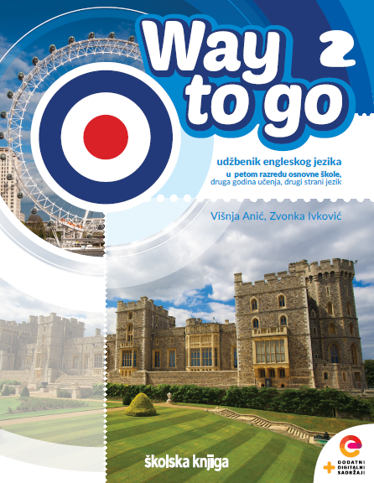

UNIT 4: Clocks and calendars
Harry Potter

Slide 2
Watch the trailer for the film Harry Potter and the Philosopher’s Stone and answer the question.
Which things fly in the film that normally don’t?
https://www.youtube.com/watch?v=VyHV0BRtdxo&ab_channel=RottenTomatoesClassicTrailers
What words do you think of when you hear the name Harry Potter?
train
broom
hat
owl
castle
a book
a film
school of magic
a boy with a scar
Gryffindor
Hufflepuff
Ravenclaw
Slytherin

Slide 3
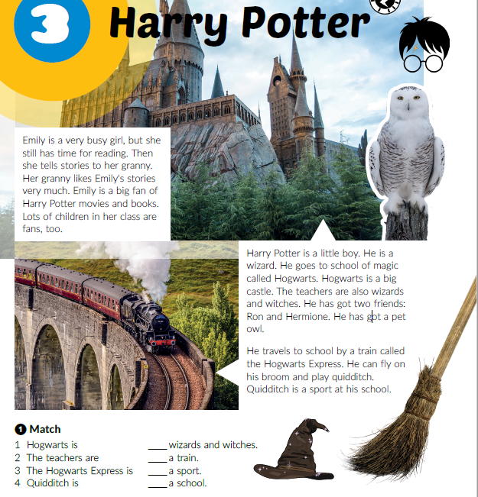
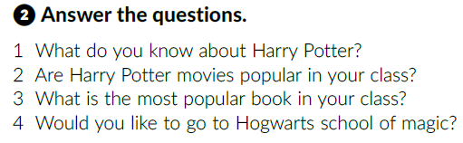
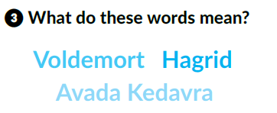
Read the text and match.
Read the text again and answer the questions.
2
3
4
1

Slide 4
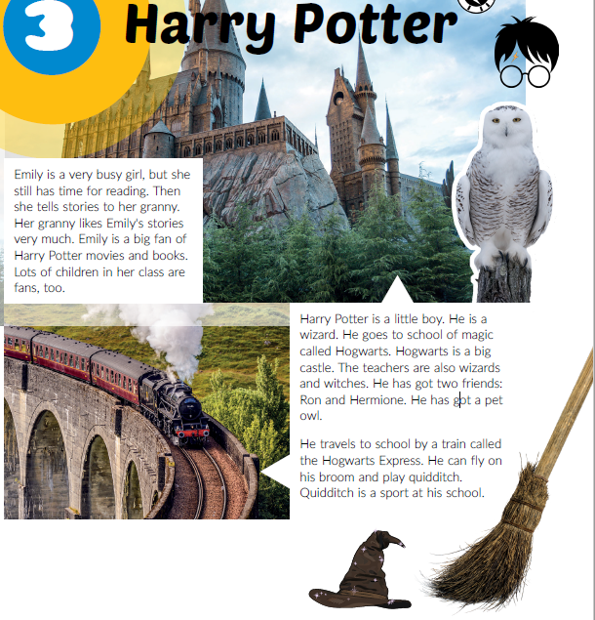
Work in groups. Imagine you are one of the characters from the book/film Harry Potter.
Write and play out a dialogue.

Slide 5

Click on the following link and choose Self check. Complete the tasks.
https://www.e-sfera.hr/dodatni-digitalni-sadrzaji/468220c0-d1ae-44de-8ea4-6a25de5a5381/

